Slide 1

Employer Drug Impairment Training (EDIT)

Slide 2

Your Instructors
Names
Agencies
Background information

Slide 3
EDIT
Session I: Introduction and Overview
Session II: Drugs in Society
Session III: Overview of Alcohol
Session IV: Drug Identification, Categories, and Their Observable Effects
Session V: Policies and Procedures
Session VI: References

Slide 4
Session I:
Goals and Overview

Slide 5
Goal of this Training:
To identify drug impaired individuals and types of drugs for the purpose of ensuring a safe working environment.

Slide 6

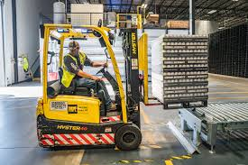
Secondary Goal
To assist in preventing an impaired employee from driving to and from the workplace or operating equipment and machinery when impaired.

Slide 7
What this training is NOT…
Not intended to qualify participants as Drug Recognition Experts (DREs)
Not designed as an enforcement tool. The information and procedures provided are for administrative purposes only

Slide 8
Objectives
Understand the goals of EDIT training
Understand how EDIT can assist in identifying drug-impaired workers
Properly recognize and describe drug impairment indicators

Slide 9
Other Objectives
Understand the involvement of drugs in the workplace and society
Discuss the major drug categories and their signs and indicators of impairment

Slide 10
Other Objectives
Identify the key factors to be considered when identifying substance abuse
Properly interpret and document the results of your observations
Understand how to make referrals to the appropriate resources
Notes:
The intention of documentation related to the work environment is intended for internal record keeping and later use for employer purposes.

Slide 11


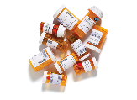
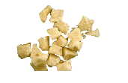
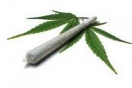
What is a Drug?
Any substance that alters perception or behavior, reducing that individual’s ability to function appropriately in the workplace.

Slide 12
Systematic and Standardized
The goal is to identify those who may be impaired by a drug or drugs:
To improve the work environment,
Provide early intervention and diversion, and
Assess the need for medical assistance
Based on the totality of the information

Slide 13

All terminology and information is based on medical and scientific facts and research, and is field tested
Signs, symptoms and indicators presented have been validated in both laboratory and field studies

Slide 14


Test Your Knowledge Time
Notes:
Some or all of the following slides can be removed based on time……

Slide 15
True or False?
Cannabis is the most commonly abused drug in society today.
FALSE
2. People under the influence of cocaine will exhibit constricted (pinpoint) pupils.
FALSE
Notes:
Question 1: Alcohol is the most commonly abused drug in society

Slide 16
True or False?
3. Large dilated pupils is an indicator of methamphetamine impairment.
TRUE
4. Eyelid tremors is associated with impairment caused by cannabis.
TRUE

Slide 17
True or False?
5. The drug fentanyl is one of the leading causes of drug overdose deaths in the U.S.
TRUE
6. Marijuana impairs a person’s attention span for normally not more than 30 minutes after use.
FALSE

Slide 18
True or False?
7. The effects of drugs effect every user basically the same.
FALSE
8. Alcohol lowers inhibitions, therefore it is best classified as a stimulant?
FALSE

Slide 19
True or False?
9. If a person’s blood alcohol level is 0.08%, it will take 2 to 4 hours of non-drinking to eliminate all alcohol and achieve a 0.00% blood alcohol level.
FALSE
10. Pinpoint constricted pupils in an impairment indicator associated with cannabis.
FALSE

Slide 20
True or False?
11. Most people abuse only one type of drug (their drug of choice) while usually not abusing other types of drugs.
FALSE
12. A person impaired by Xanax will appear similar to someone impaired by alcohol.
TRUE

Slide 21

END OF SESSION I

Slide 22
Session II: Drugs In Society

Slide 23
National Statistics
52 million Americans aged 12 and older reported use of a prescription drug outside of its intended purpose within the past month
The United States holds 5% of the world’s population, but consumes 75% of the world’s prescription drugs
(Source: National Institute of Drug Abuse)

Slide 24
Self-Reported Drug Use
In 2018, an estimated 53.2 million Americans aged 12 or older used illicit drug within the past year, representing 19.4% of the population
Marijuana was the most common, used by 43.5 million people, representing nearly 82% of all illicit drug use
The misuse of prescription pain relievers was the second most common, with approximately 9.9 million people reporting use within the past year
Source: National Survey on Drug Use and Health (NSDUH)
Notes:
The following summarizes the self-reported drug usage information as reported by the 2018 NSDUH Survey:
In 2018, NSD
UH changed to annual reporting and no longer reports use within the past month.. This figure represents 1 in 5 people in the United States as having used an illicit drug in the past year.
Marijuana was used by approximately 82 percent of all current illicit drug users
Remind the participants the numbers are very conservative due to self-reporting.

Slide 25
Prescription Drug Abuse/Misuse
Three classes of prescription drugs commonly abused:
Opioids, or Narcotic Analgesics, which are most often prescribed to treat pain (Fentanyl, Oxycodone, Hydrocodone, Morphine, etc.)
Central Nervous System (CNS) Depressants: Used to treat anxiety and sleep disorders (Xanax, Ambien, Prozac, Valium, etc.)
CNS Stimulants: Illicit drugs and prescribed to drugs treat sleep disorder narcolepsy and attention-deficit hyperactivity disorder (Methamphetamine, Cocaine, Amphetamines)

Slide 26
National Statistics
Illicit Drugs
In 2018 an estimated 5.5 million Americans aged 12 and up used cocaine in the past year
During the same period, approximately 5.1 million Americans reported illicit use of prescription stimulants
An estimated 808,000 people reported using Fentanyl in 2018, nearly double the reported use in 2014
(Source: 2018 National Survey on Drug Use and Health)
Notes:
5.5 million users of cocaine includes 757,000 users of crack. These figures represent about 2% of the population as cocaine users and about.3% used crack.
5.1 million illicit users of prescription stimulants includes drugs such as Ritalin and Cylert.
Source: NSDUH 2018 Survey

Slide 27
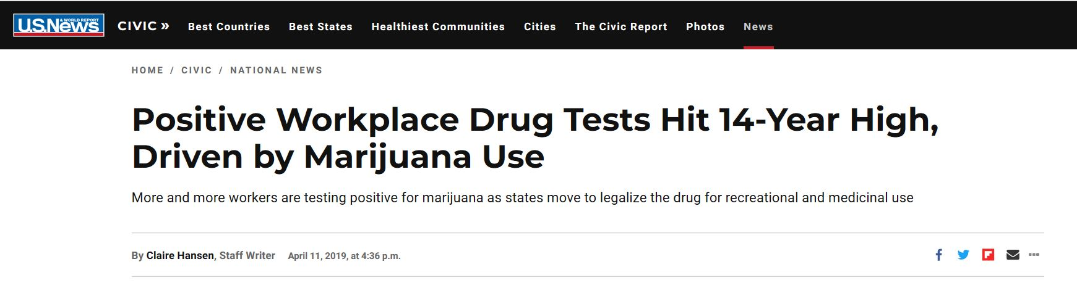
Results from more than 10 million workplace drug tests by Quest Diagnostics
5% increase over 2017, the highest rate since 2004
4.4% of workers and job applicants tested positive for drugs
24% increase for safety sensitive workforce (Airplane Pilots, Train Conductors) from 2014 to 2018

Slide 28

Drugs and Alcohol in the Workplace
www.Youtube.com/watch?v=rMjBNeXXuRM

Slide 29
Workforce Marijuana Positivity Increase By State (2018)
Oregon - 63%
Nevada - 55%
Colorado - 47%
National average - 2.3%
Overall workplace positivity increased by 10%
Source: Smart Approaches to Marijuana (SAM) April 2019

Slide 30
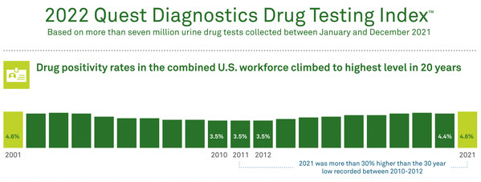
Positive Workforce Drug Tests - 2021

Slide 31
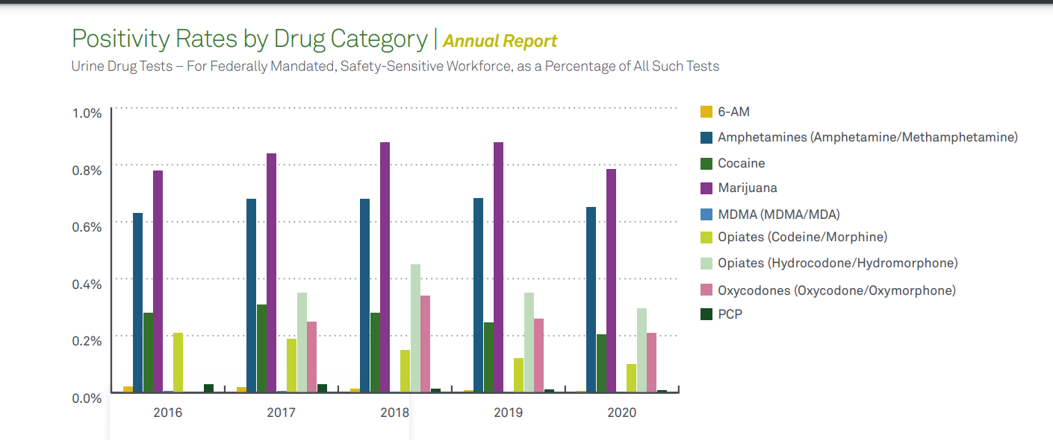
Source: Quest Diagnostics 2021 Annual Report and Industry Insights

Slide 32



Slide 33
State and Local Statistics
Drug usage trends
Common drugs of abuse
New drugs of abuse
Notes:
This slide is optional and allows for information related to the area of the presentation to be added

Slide 34
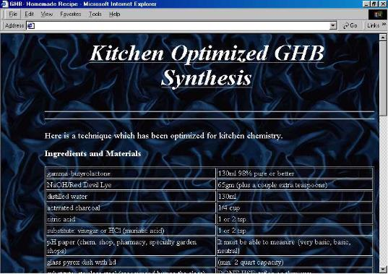
Drugs on the Internet
Notes:
Sites like Erowid.com and youtube as well as other social networks where people share their experiences related to drug use.

Slide 35

END OF SESSION II

Slide 36
Session III:
Overview of Alcohol

Slide 37
Alcohol is a CNS Depressant
Alcohol is the most abused drug in the United States
Notes:
Ethanol is a Central Nervous System Depressant. It doesn't affect a person until it gets into their Central Nervous System, i.e., the brain, brain stem and spinal cord. Ethanol gets to the brain by getting into the blood. In order to get into the blood, it has to get into the body.
There are actually a number of different ways in which ethanol can get into the body. It can be inhaled. Ethanol fumes, when taken into the lungs, will pass into the bloodstream and a positive BAC will develop. However, prolonged breathing of fairly concentrated fumes would be required to produce a significantly high BAC.
Ethanol could also be injected, directly into a vein; it would then flow with the blood back to the heart, where it would be pumped first to the lungs and then to the brain. And, it could be inserted as an enema and pass quickly from the large intestine into the blood. But none of these methods are of any practical significance because alcohol is almost always introduced into the body orally, i.e., by drinking.

Slide 38

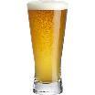
Physiology of Alcohol
A family of closely-related chemicals whose molecules are made up of hydrogen, carbon, and oxygen.
Notes:
The word “Alcohol” refers to several distinct, but similar chemicals. Each of the alcohols is a drug within the scope of our definition. Only one can be tolerated by the human body in substantial quantities.

Slide 39
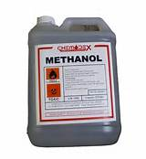

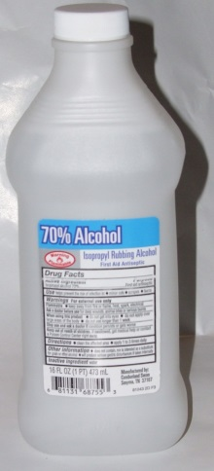
Some Types of Alcohol
Methyl Alcohol (Methanol)
Ethyl Alcohol (Ethanol)
Isopropyl Alcohol (Isopropanol)
Notes:
Ask the question: What are the names of some types of alcohols?
Three of the more commonly known alcohols are Methyl, Ethyl, and Isopropyl.
• Methyl alcohol also known as Methanol or wood alcohol
• Ethyl alcohol also known as Ethanol or beverage alcohol
• Isopropyl Alcohol (Isopropanol) also known as rubbing alcohol

Slide 40
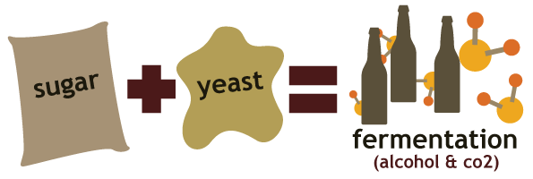
Ethanol Production - Fermentation
Yeast combines with sugars from fruit or grains in a chemical reaction resulting in ETOH.
Notes:
Ethanol is what interests us because it is the kind of alcohol that features prominently in impaired driving. Ethanol is beverage alcohol, the active ingredient in beer, wine, whiskey, liquors, etc. Ethanol production starts with fermentation. That is a kind of decomposition in which the sugars in fruit, grains, and other organic materials combine with yeast to produce the chemical we call ethanol. This can occur naturally, as yeast spores in the air come into contact with decomposing fruit and grains. However, most of the ethanol in the world didn't ferment naturally, but was produced under human supervision.
When an alcoholic beverage is produced by fermentation, the maximum ethanol content that can be reached is about 14%. At that concentration, the yeast dies, so the fermentation stops. Obtaining a higher ethanol content requires a process called distillation. This involves heating the beverage until the ethanol "boils off," then collecting the ethanol vapor. It is possible to do this because ethanol boils at a lower temperature than does water.
Point out humans almost certainly first encountered ethanol that had been produced accidentally in this fashion.
Ask the question: "Why can't fermentation produce a higher ethanol concentration than 14%?” .
Point out ethanol starts to boil at a lower temperature than water does.

Slide 41
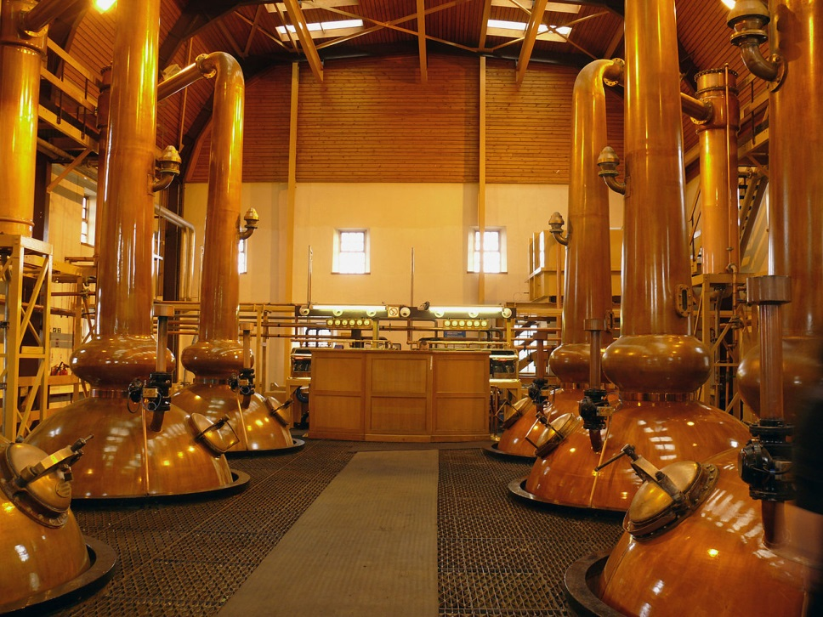
Ethanol Production - Distillation
Fermented beverage is boiled at a controlled temperature to extract and concentrate the ethanol fumes.
Notes:
Ask participants to name some distilled spirits (whiskey, vodka, gin, rum).
Distilled spirits is the name we give to high ethanol concentration beverages produced by distillation. These include rum, whiskey, gin, vodka, etc. The ethanol concentration of distilled spirits usually is expressed in terms of proof, which is a number corresponding to twice the ethanol percentage.
For example, an 80-proof beverage has an ethanol concentration of 40%.

Slide 42
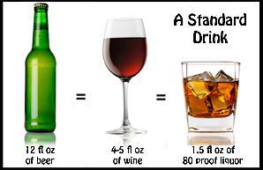
Standard-Sized Drinks
Bottle of Beer
12 ounces @ 5% alcohol equals 0.60 ounces of pure alcohol
Glass of Wine
5 ounces @ 12% alcohol equals 0.60 ounces of pure alcohol
Shot of Whiskey (80-proof)
1 and 1/2 ounces @ 40% alcohol equals 0.60 ounces of pure alcohol

Slide 43
Absorption of Alcohol
Stomach Walls
Stomach Walls
Getting the ethanol out of the stomach and into the blood
20%
Pylorus
Stomach Walls
80%

Slide 44

Distribution of Alcohol
Getting the ethanol into the body’s tissues and organs
BASIC PRINCIPLE
Ethanol goes wherever it finds water
Notes:
Once the alcohol moves from the stomach into the blood, it will be distributed throughout the body by the blood. Alcohol has an affinity for water. The blood will carry the alcohol to the various tissues and organs of the body and will deposit the alcohol in them in proportion to their water contents.
Brain tissue has a fairly high water content so the brain receives a substantial share of the distributed alcohol. Muscle tissue also has a reasonably high water content but fat tissue contains very little water. Thus, very little alcohol will be deposited in the drinker's body fat. This is one factor that differentiates alcohol from certain other drugs, notably PCP and THC, which are very soluble in fat.

Slide 45
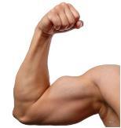
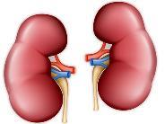
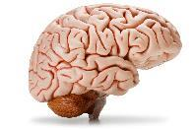
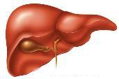
Which body parts contain a lot of water?
Brain Liver Muscle Tissue Kidneys
Which body parts contain very little water?
Bones and Fatty Tissue

Slide 46
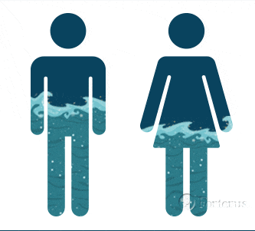
Alcohol Facts by Gender

Slide 47


Elimination of Alcohol
Getting the ethanol out of the body:
Direct excretion
Breath
Urine
Sweat, Tears
Metabolism
Notes:
As soon as the alcohol enters the blood stream, the body starts trying to get rid of it. Some of the alcohol will be directly expelled from the body chemically unchanged. For example, some alcohol will leave the body in the breath, urine, sweat, tears, etc. However, only a small portion (about 2-10%) of the ingested alcohol will be directly eliminated.
Most of the alcohol a person drinks is eliminated by metabolism. Metabolism is a process of chemical change. In this case, alcohol reacts with oxygen in the body and changes through a series of intermediate steps into carbon dioxide and water, both of which are directly expelled from the body.
Ask the question: What organ in the body is primarily responsible for chemically breaking the alcohol down?
Click to reveal answer to question on next slide.

Slide 48

END OF SESSION III

Slide 49
Session IV:
Drug Identification, Categories and Their Observable Effects

Slide 50
Session IV - Objectives
Define the word “drug” and other terms associated with drug impairment
For each of the drug categories:
- Identify common drug types
- Discuss the different signs of ingestion
- Identify the general indicators of impairment

Slide 51
Session IV - Objectives
Be familiar with conditions that may mimic indicators of drug impairment
Become familiar with overdose symptoms of the drug categories
Gain a better understanding of why people abuse drugs

Slide 52
Definition of a Drug
Any substance that alters perception or behavior, reducing that individual’s ability to function appropriately in the work environment.

Slide 53
Drug Categories
Central Nervous System Depressants
Central Nervous System Stimulants
Hallucinogens
Dissociative Anesthetics
Narcotic Analgesics
Inhalants
Cannabis

Slide 54
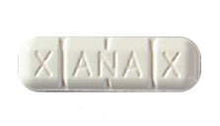
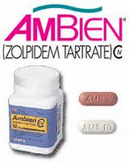
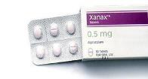
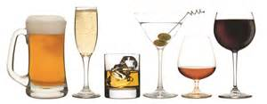
Central Nervous System Depressants

Slide 55

Most Familiar CNS Depressant - Alcohol

Slide 56

How Does Alcohol Make You Drunk
https://video.link/w/OAecc

Slide 57
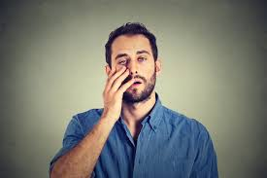
General Impairment Indicators
Drowsiness
Thick slurred speech
Uncoordinated, fumbling
Flaccid muscle tone
Sluggish
Eyelids may be droopy
Eyes may be bloodshot and watery
Slowed reflexes

Slide 58

Conditions That May Mimic CNS Depressant Impairment
Extreme fatigue
Head injury
Hypotension (low blood pressure)
Severe depression
Diabetic problems
Inner ear disorders

Slide 59

CNS Depressant Overdose Symptoms
Shallow breathing
Cold/clammy skin
Dilated pupils
Slow heartbeat

Slide 60
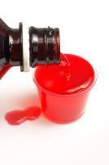
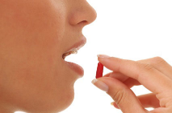
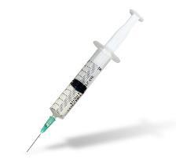
Methods of Ingestion
Oral - Primary method of ingestion
Injected

Slide 61

Duration of Effects
Depending on the type of depressant, the effects can last from a few minutes to approximately fourteen hours.

Slide 62

Questions Regarding
CNS Depressants?

Slide 63
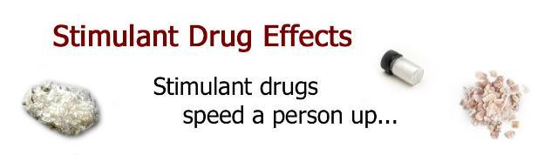
Central Nervous System Stimulants

Slide 64
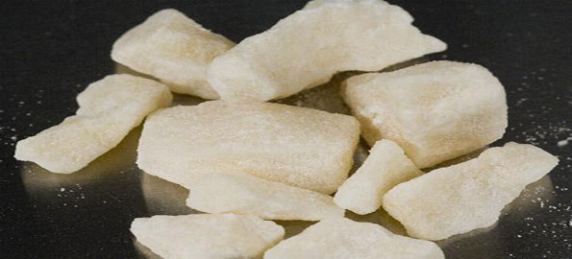
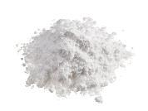
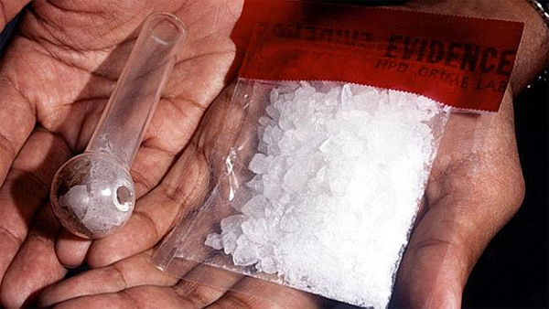

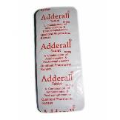
Various CNS Stimulants
Cocaine / Crack
Amphetamines
Methamphetamine
Prescription “General Cellular” Stimulants
Herbal and Over-the-Counter Stimulants

Slide 65

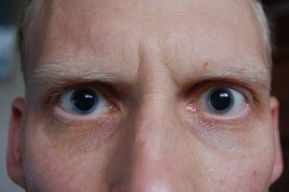
General Impairment Indicators
- Restlessness - Body tremors
- Anxiety - Grinding teeth (Bruxism)
- Excited - Exaggerated reflexes
- Runny nose - Talkative
- Paranoia - Euphoric
- Dry mouth - Irritability
- Loss of appetite - Loss of weight
- Dilated pupils

Slide 66

Conditions That May Mimic CNS Stimulant Symptoms
Hyperactivity
Nervousness
Stress
Fear
Hypertension (high blood pressure)

Slide 67

CNS Stimulant Overdose Symptoms
Confusion
Feelings of pleasure to panic
Convulsions
Fainting
Aggressiveness
Dramatic increase in heart rate
Hallucinations
Coma

Slide 68
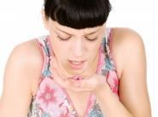
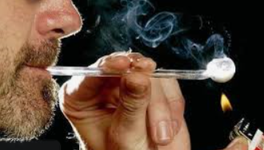
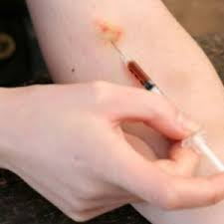
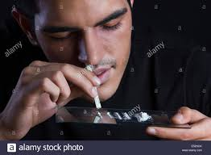
Methods of Ingestion
Oral
Smoking
Replace pic
Snorting
Injecting

Slide 69

Duration of Effects
Cocaine - Up to 2 hours
Amphetamines - 4 to 8 hours
Methamphetamine - Up to 12 hours
Ritalin / Adderall / Dexedrine – Varies

Slide 70

Questions Regarding
CNS Stimulants?

Slide 71
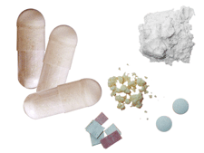
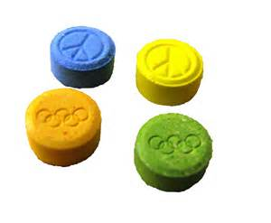
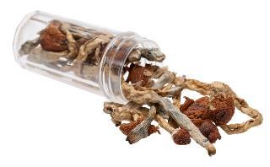
Hallucinogens

Slide 72

Hallucinogens
Drugs that can cause hallucinations
The user may perceive things differently from the way they actually are

Slide 73
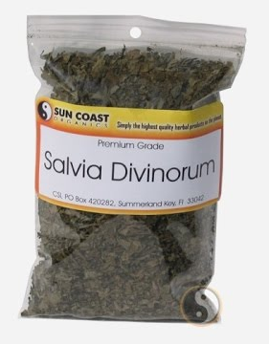
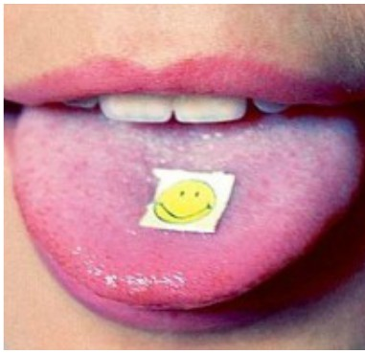
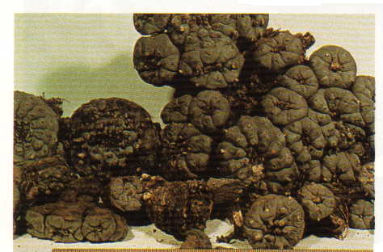
Hallucinogens
Peyote
Salvia Divinorum
LSD
MDMA (Ecstasy)
Notes:
Hallucinogens
Hallucinogens are drugs that affect a person’s perceptions, sensations, thinking, self awareness, and emotions.
Definition from The Random House College Dictionary (Revised Edition, 1980).
One common type of hallucination caused by these drugs is called synesthesia, which means a transposing of the senses.
Sounds, for example, may be transposed into sights.
Example: the user may “see” a flash of color whenever the telephone rings.
Sights, for example, may be transposed into odors or sounds.
Example: the user may “smell” a particular fragrance when he or she looks at something painted red.
Some hallucinogenic drugs come from natural sources:
Peyote is a Hallucinogen found in a particular species of cactus
Psilocybin is a Hallucinogen found in a number of species of mushroom
Other Hallucinogens are synthetically manufactured:
LSD (Lysergic Acid Diethylamide)
MDA (3,4-Methylenedioxyamphetamine)
MDMA (3,4-Methylenedioxymethamphetamine or Ecstasy)
Many others

Slide 74

General Impairment Indicators
Hallucinations
Body tremors
Paranoia
Uncoordinated
Nausea
Disoriented
Dilated pupils
Perspiring
Memory loss
Dazed appearance
Flashbacks
Difficulty with speech
Synesthesia (Transposition of senses)

Slide 75
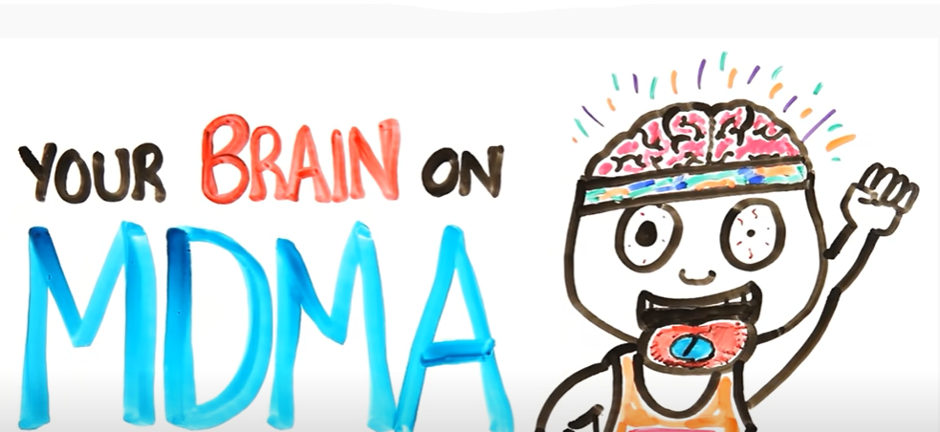
MDMA – “Ecstasy”
www.youtube.com/watch?v=jEAr7ThsYew

Slide 76

Conditions That May Mimic Hallucinogen Symptoms
- High fever
- Mental illness

Slide 77
Possible Hallucinogen Overdose Symptoms
The most common danger of an overdose on a hallucinogen is an intense bad trip, which can result in severe and sometimes permanent psychosis.
Accidental death or suicide may also result from an intense trip.

Slide 78

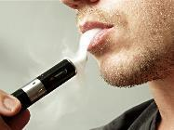
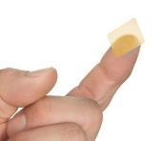
Methods of Ingestion
Oral
Smoking
Transdermal
Snorting
Injecting

Slide 79
Duration of Effects
LSD
Up to 12 hours
MDMA Psilocybin Mushrooms
4 to 24 hours 3 to 5 hours

Slide 80

Questions Regarding
Hallucinogens?

Slide 81
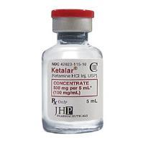

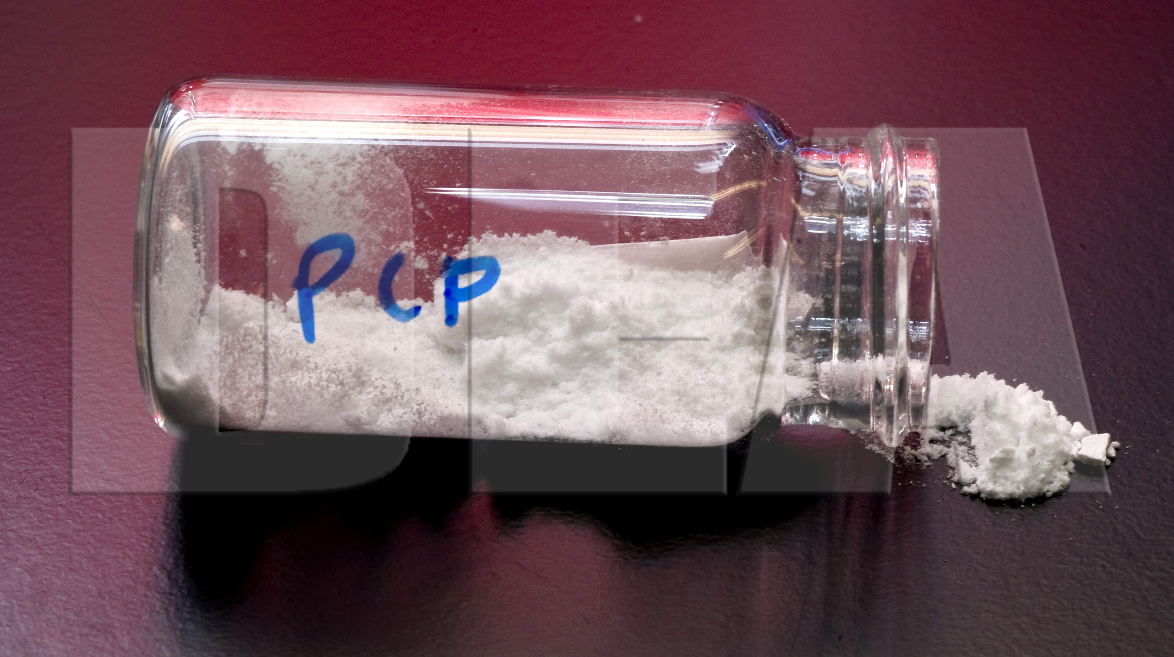
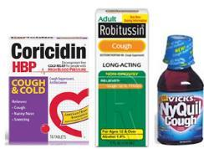
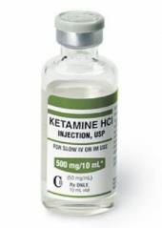
Dissociative Anesthetics

Slide 82

PCP and Its Analogs
Phencyclidine is a shortened form of the chemical name PhenylCyclohexylPiperidine or PCP

Slide 83

General Indicators
- Blank stare
- Loss of memory
- Confused
- Warm to touch
- Incomplete, slurred verbal responses

Slide 84

Other General Indicators
Repetitive speech
Cyclic behavior
Hallucinations
Heavy perspiring
Possibly violent and combative

Slide 85

Conditions That May Mimic Dissociative Anesthetic Symptoms
Mental illnesses

Slide 86

Overdose Signs and Symptoms
Deep coma, lasting up to 12 hours
Seizures and convulsions
Respiratory depression
Possible cardiac problems
Bizarre, violent and self-destructive behavior

Slide 87


Methods of Ingestion
Smoking
Oral
Transdermal
Snorting
Injecting

Slide 88

Duration of Effects
Onset Peak Duration
PCP 1-5 min 15-30 min 4-6 hours
Ketamine 1-5 min 15-30 min 4-6 hours
DXM rapidly absorbed 2.5 hours 3-6 hours

Slide 89

Questions Regarding
Dissociative Anesthetics

Slide 90






Narcotic Analgesics

Slide 91

Generalized Effects
Euphoria
Relief from pain
Relief from the symptoms of withdrawal

Slide 92

Fentanyl
https://www.youtube.com/watch?v=C0tW8FWBm1g

Slide 93

Tolerance

Slide 94


Narcotic Analgesics
Natural Alkaloids: Occur naturally in Opium
Synthetics: Chemically produced Narcotic Analgesics with no relation to opium but produce similar effects

Slide 95


Narcotic Analgesics
Commonly abused narcotic analgesics include:
- Hydrocodone
- Vicodin
- Tramadol (Ultram)
- Tylenol 3 (with codeine)
- Darvocet
- Morphine
- Oxycontin
- Suboxone

Slide 96




Oxycontin
Fentanyl

Slide 97



General Impairment Indicators
Facial itching
Dry mouth
Euphoria
Flaccid muscle tone
Injection marks
“On the nod”
Slowed reflexes
Low, slow, raspy speech
Constricted pupils

Slide 98

Conditions That May Mimic Narcotic Analgesic Symptoms
Extreme fatigue
Head injury
Hypotension
Severe depression
Diabetic problems

Slide 99

Overdose Signs and Symptoms
Slow and shallow breathing
Clammy skin
Blue lips
Pale or blue skin color

Slide 100


Methods of Ingestion
Injected
Smoked
Snorted
Oral
Suppositories
Transdermal

Slide 101

Duration of Effects
Drug Onset Duration
Heroin
Fentanyl
Dilaudid
Percodan
5-30 minutes
5-30 minutes
15 minutes
15 minutes
3-5 hours
2–3 hours
5 hours
4-6 hours

Slide 102



Narcan Administration

Slide 103

Questions Regarding
Narcotic Analgesics

Slide 104





Inhalants

Slide 105


Common Inhalant Types
Volatile solvents (gasoline, paint thinner)
Aerosols (hair spray, keyboard cleaner)
Anesthetic gases (Ether, Nitrous Oxide)

Slide 106


General Indicators
Odor of inhaled substance
Dizziness, numbness
Traces of substance around the face and nose
Bloodshot, watery eyes
Distorted perception, time and space

Slide 107

More General Indicators
Inebriation similar to alcohol intoxication
Intense headache
Nausea
Possible hallucinations
Slurred speech

Slide 108

Conditions with Similar Symptoms
Severe head injury
Inner ear disorders

Slide 109


Methods Of Ingestion

Slide 110

Duration of Effects
Substance Onset Duration
Nitrates Immediately Up to 20 minutes
Nitrous Immediately 5 minutes or less
Oxide
Volatile Immediately 6-8 Hours
Solvents

Slide 111

Questions Regarding
Inhalants

Slide 112





Cannabis

Slide 113
Cannabis
The primary psychoactive ingredient in Cannabis: Delta-9 Tetrahydrocannabinol (THC)

Slide 114

Marijuana
https://www.youtube.com/watch?v=oeF6rFN9org&t=12s

Slide 115





Marijuana Hashish
Wax/Dabs
Hash Oil Marinol
Types of Cannabis

Slide 116



Edibles

Slide 117

Edible Cannabis
https://www.youtube.com/watch?v=pUhJnKKQDTE

Slide 118


Synthetic Cannabinoids
K2
Spice
Crush
JWH-018, HU-210
Many more
Notes:
Generally found as dried plant material
Leaves sprayed with lab-created chemicals
Can be crystalline substance, similar in appearance to methamphetamine
Much of it comes overseas from Asia
Originally sold in head shops, gas stations, convenience stores as herbal incense or potpourri
Most often obtained through the internet
Labeled “Not For Human Consumption”

Slide 119

Synthetic Cannabinoids
“A good number of users cite visual and auditory distortions while high. The heart rate soars, the mouth gets dry, and sweating begins.”
“The relaxing and loquacious effects of marijuana smoking have been replaced by agitation and anxiousness.”
“Synthetic THC is a potential trigger for serious, psychotic episodes for some users.”
Source: "Reports from the Field: Spice Smoking Causes Psychosis in an Otherwise Healthy User Medtox Journal on Drug Abuse Recognition, June 2012

Slide 120

General Indicators
Odor of marijuana
Relaxed inhibitions
Red, bloodshot eyes
Body tremors
Disorientation
Impaired attention
Dilated pupils

Slide 121

Overdose Signs and Symptoms
Severe personality changes
Paranoia
Possible psychosis
Vomiting (Cannabinoid Hyperemesis Syndrome)

Slide 122

Duration of Effects
Onset Peak Duration
2-3 Hours
4-6 Hours
4-6 Hours
Marijuana
Immediate
Hashish
Immediate
Marinol
30 min – 1 hour
10-30 Minutes
10-30 Minutes
2 to 4 Hours

Slide 123

Questions Regarding
Cannabis?

Slide 124
Drug Combinations
Polydrug use - having two or more drugs in the body at the same time
Notes:
Polydrug can be two or more drugs from the same category example Xanax and Valium
PolyCategory more than one category of drugs in the system at the same time example heroin (Narcotic) and Cocaine (stimulant) This would be both polydrug (more than one drug) and poly category (more than one category)

Slide 125

Polydrug Use

Slide 126
Why Do People Mix Drugs?
Attempt to increase the effect of another drug or to ‘bring on’ its desired effects.
Attempt to reduce the negative effects of a drug, usually when ‘coming down’ from that drug.
Substitute for the drug their drug of choice, ‘the next best thing’
Seemed like a ‘good idea at the time’. Sometimes people will mix drugs when they are already intoxicated, aren’t thinking straight or if people around them are mixing drugs.

Slide 127

Combining Alcohol and Marijuana
https://www.youtube.com/watch?v=zTeaOTkjut0

Slide 128
Medical Issues
Some medical conditions may mimic drug induced impairment from polydrug use
Diabetes
Brain disorders
Injuries

Slide 129

Questions Regarding
Drug Combinations

Slide 130



SESSION V: Policy and Procedures

Slide 131
Company Polices
WHAT is your company policy?
WHERE can employees go for help in your company?
Notes:
This is opportunity to ask participants about their policy to see if they are familiar with it. Instructor should be aware of any agency policy prior to presenting.
Does the employer offer any rehabilitation/support programs?

Slide 132



Notes:
This is opportunity to ask students about their policy to see if they are familiar with it. Instructor should be aware of any agency policy prior to presenting.
Does the employer offer any rehabilitation/support programs?

Slide 133

Suggestions When Talking With Employees
Plan ahead.. Is this HR, supervisor or responsibility of someone else?
Have HR representative present during the conversation
“We observed”. . .
Appearances
Describe behavior – be specific
Express concern
Notes:
What is company policy on who will address the employee?
It is beneficial to have more than one person from the employer present to address the employee. This avoids it becoming “personal” or word of one against another.

Slide 134

Words Which May Result in a Negative Reaction
Diagnosed
Drugs
Loaded
High
Drunk
Suspect
Arrest
Out of Control
Crazy
Jail
Others?

Slide 135
Questions Regarding
Contact With Employees?

Slide 136

SESSION VI: References

Slide 137
Internet Resources
http://www.nida.nih.gov/
Specific pages about drugs of abuse, drug trends, and treatment options
http://www.erowid.org
Pro-drug site with drug information
http://www.nhtsa.dot.gov
Site for highway safety information, statistics
http://www.ndaa.org
Legal issues, materials explaining drug assessment procedures in lay terms

Slide 138

Printed Resources
Physician’s Desk Reference
Drug Identification Bible
The Internet

Slide 139

EDIT Training
Review of EDIT drug matrix
Post-Test
Critique
Final Comments / Questions / Concerns

Slide 140

Contact information:

